Slide 1
Fundamentos de bases de datos ISW­-312

Slide 2


Fundamentos de bases de datos ISW­-312
Universidad Técnica Nacional
Por: Efrén Jiménez Delgado
2019

Slide 3
Agenda
Joins
JOIN or INNER JOIN
OUTER JOIN
CROSS JOIN
SELF JOIN

Slide 4

What is an SQL JOIN?
Is a method to recover data from two or more database tables.

Slide 5

TYPES OF JOIN?
There are 4 types of JOIN that can be implemented in a SQL Database.
JOIN or INNER JOIN
OUTER JOIN
CROSS JOIN
SELF JOIN

Slide 6
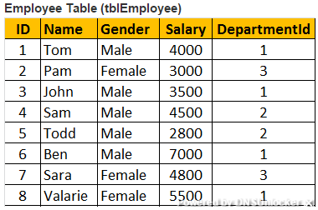
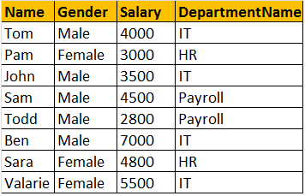
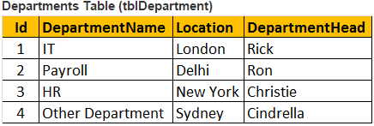
JOIN OR INNER JOIN

Slide 7
JOIN OR INNER JOIN
Select Name, Gender, Salary, DepartmentName
FROM tblEmployee INNER JOIN tblDepartment
On tblEmployee. tblDepartmentId = tblDepartment.Id;
OR
Select Name, Gender, Salary, DepartmentName
FROM tblEmployee JOIN tblDepartment
On tblEmployee. tblDepartmentId = tblDepartment.Id;

Slide 8
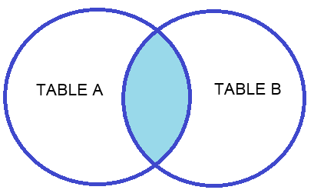
JOIN OR INNER JOIN

Slide 9
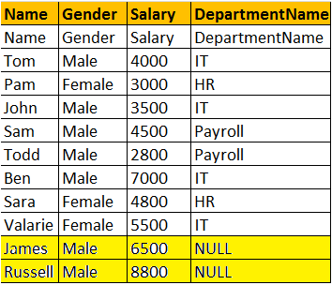
LEFT JOIN or LEFT OUTER JOIN

Slide 10
LEFT JOIN or LEFT OUTER JOIN
Select Name, Gender, Salary, DepartmentName
FROM tblEmployee LEFT OUTER JOIN tblDepartment
On tblEmployee. tblDepartmentId = tblDepartment.Id;
OR
Select Name, Gender, Salary, DepartmentName
FROM tblEmployee LEFT JOIN tblDepartment
On tblEmployee. tblDepartmentId = tblDepartment.Id;

Slide 11
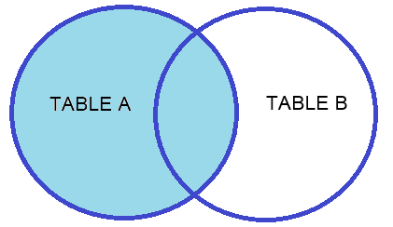
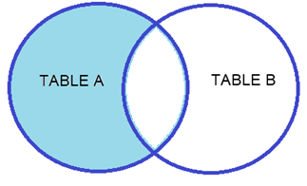
LEFT JOIN or LEFT OUTER JOIN

Slide 12
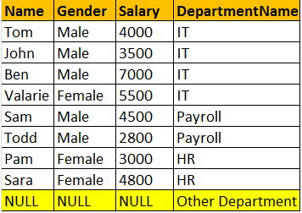
RIGHT JOIN or RIGHT OUTER JOIN

Slide 13
RIGHT JOIN or RIGHT OUTER JOIN
Select Name, Gender, Salary, DepartmentName
FROM tblEmployee RIGHT OUTER JOIN tblDepartment
On tblEmployee. tblDepartmentId = tblDepartment.Id;
OR
Select Name, Gender, Salary, DepartmentName FROM tblEmployee RIGHT JOIN tblDepartment
On tblEmployee. tblDepartmentId = tblDepartment.Id;

Slide 14
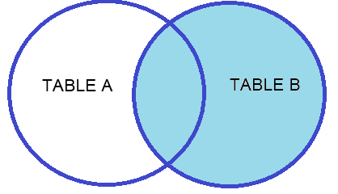
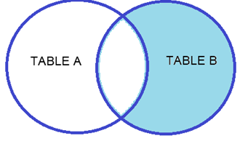
RIGHT JOIN or RIGHT OUTER JOIN

Slide 15
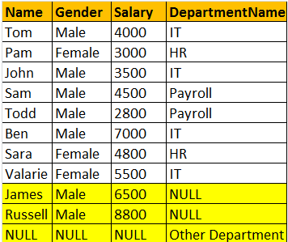
FULL JOIN OR FULL OUTER JOIN

Slide 16
FULL JOIN OR FULL OUTER JOIN
Select Name, Gender, Salary, DepartmentName
FROM tblEmployee FULL OUTER JOIN tblDepartmentOn tblEmployee. tblDepartmentId = tblDepartment.Id;
OR
Select Name, Gender, Salary, DepartmentName
FROM tblEmployee FULL JOIN tblDepartmentOn tblEmployee. tblDepartmentId = tblDepartment.Id;

Slide 17
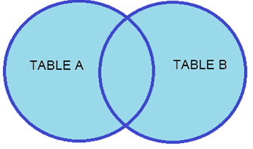
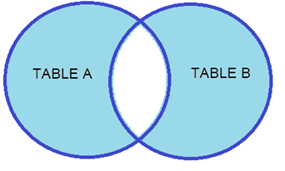
FULL JOIN OR FULL OUTER JOIN

Slide 18
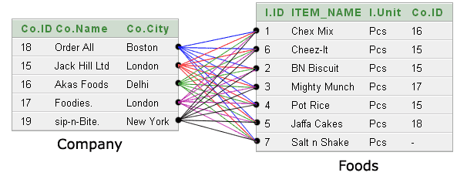
CROSS JOIN

Slide 19
CROSS JOIN
Select foods.item_name, foods.item_unit,company.company_name, company.company_cities
FROM foods CROSS JOIN company;

Slide 20
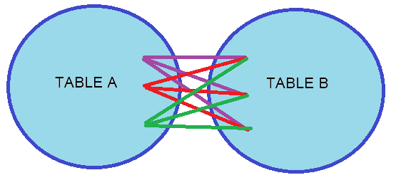
CROSS JOIN

Slide 21
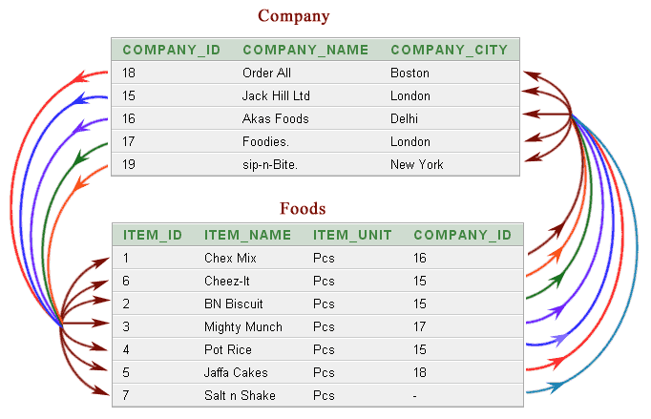
CROSS JOIN

Slide 22
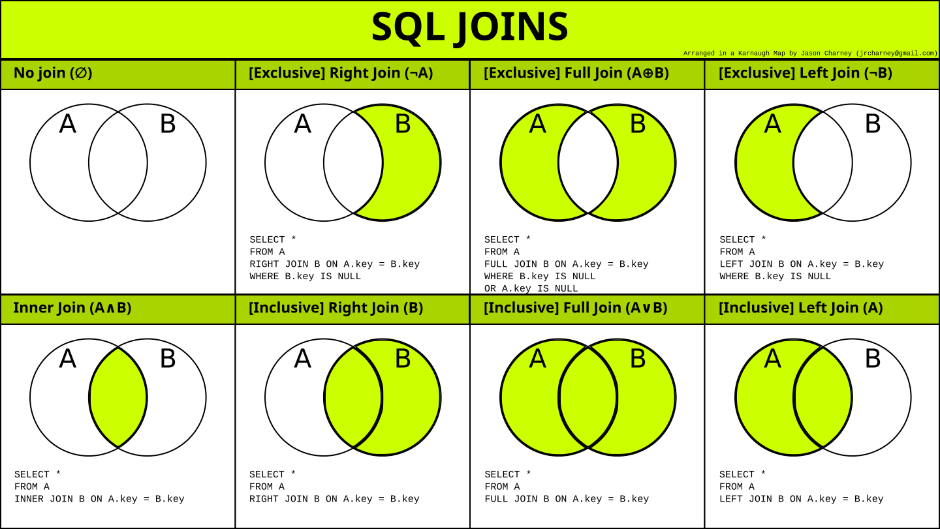
Resumen

Slide 23

Practica

Slide 24
Bibliografía
http://www.tutorialesprogramacionya.com/postgresqlya/index.php
https://www.w3schools.com/sql/sql_join.asp

